Slide 1
Unit -6
Memory
PLD
Converters ADC-DAC

Slide 2
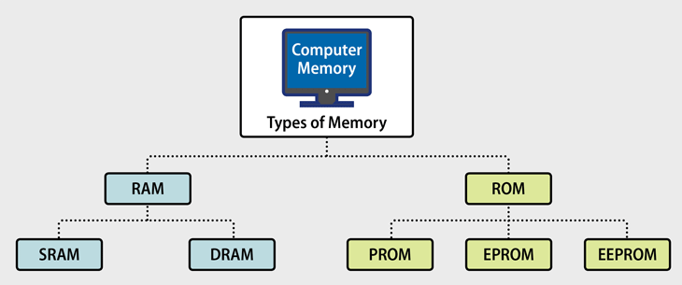
Memory
Memory is the most essential element of a computing system because without it computer can’t perform tasks.
Computer memory is of two basic type – Primary memory(RAM and ROM) and Secondary memory(hard drive, CD,etc.)
Random Access Memory (RAM) is volatile memory and Read Only Memory (ROM) is non-volatile memory.

Slide 3
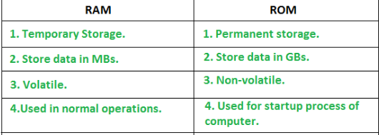
Random Access Memory (RAM)
Read write memory
The programs and data that the CPU requires during execution of a program are stored in RAM
It is a volatile memory as the data loses when the power is turned off.
Further classified into two types-
SRAM (Static Random Access Memory)
DRAM (Dynamic Random Access Memory)
Stores crucial information essential to operate the system, like the program essential to boot the computer.
It is non volatile.
Always retains its data.
Used in embedded systems or where the programming needs no change.
Used in calculators and peripheral devices.
ROM is classified into 4 types- ROM, PROM, EPROM, and EEPROM.
Read Only Memory (ROM)

Slide 4
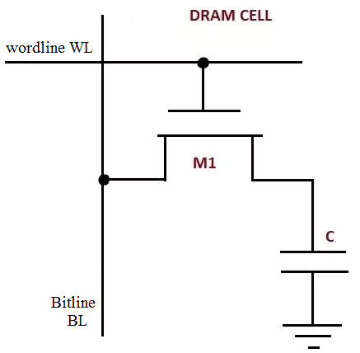
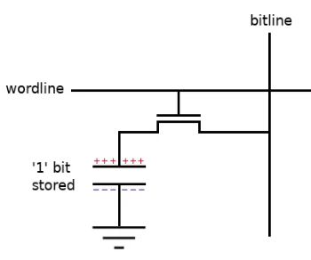
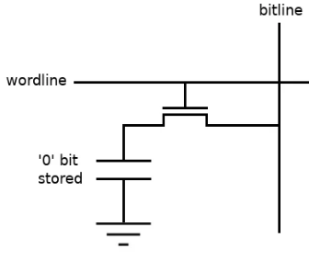
DRAM Cell – Read Write
DRAM Cell single transistor that is paired with a capacitor (1T1C)
DRAMs store data in cells that depend on capacitors, which need to be 'refreshed'
A bit in DRAM can be stored as the presence or absence of charge on a capacitor.
DRAM IC has address lines, data lines, and control lines.
Word lines identify the location of the memory cell to be read from or written Bit lines contain the value of the data read or being written
Read operation
Word line turns on the access transistor.
Transistor allows the voltage on the capacitor to be read by a
sensitive amplifier circuit through the 'bit' line.
sense circuit determine whether a '1' or '0' in the memory cell
by comparing the sensed capacitor voltage against a threshold
Write operation
Data to be written ('1' or '0') is provided at the 'bit' line
word line turns on the transistor and allows the capacitor to
charge up or discharge, depending on the state of the bit line.
Sense Circuit

Slide 5
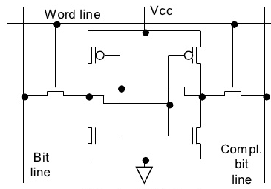
SRAM Cell Read Write
6 Transistor (6T Cell)
stored data can be retained indefinitely, as long as the power supply is on,
without need for periodic refresh operation
one-bit memory cell
Read
1. WL = 1
2. Access transistors are turned ON
3. BL and BL_bar values are read by Sense Amplifier
Write
1. WL = 1
2. Access transistors are turned ON
3. BL and BL_bar values are stored in cell

Slide 6
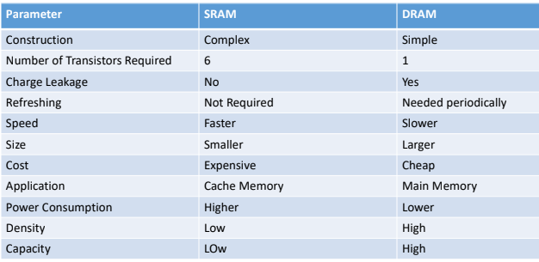

Slide 7
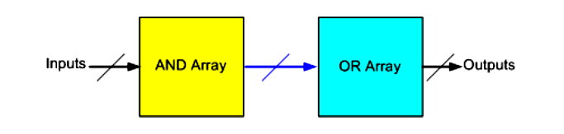
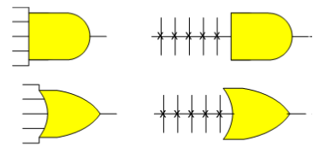
PLD (Programmable Logic Devices)
An electronic component used to build reconfigurable digital circuits
Contain an array of AND gates & another array of OR gate with programmable features
internal logic gates or connections of PLDs can be changed or configured by a programming process
simplest programming technologies is to use fuses
3 Type of PLD are
Programmable Array Logic
Programmable Logic Array
Programmable Read Only Memory
Advantages of using PLDs
less board space, faster, lower power requirements, less costly assembly processes, higher reliability, availability of design software

Slide 8
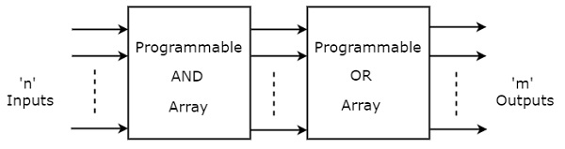
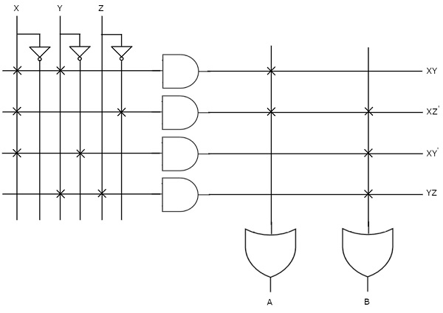
Programmable Logic Array PLA
Both Programmable AND array & Programmable OR array
Programmable AND array generates product term and programmable OR array generate sum term
A PLA output in SOP format
The symbol ‘X ’ is used for programmable connections
Implement the following equation using PLA
A=XY+XZ’
B=XY’′+YZ+XZ’′

Slide 9
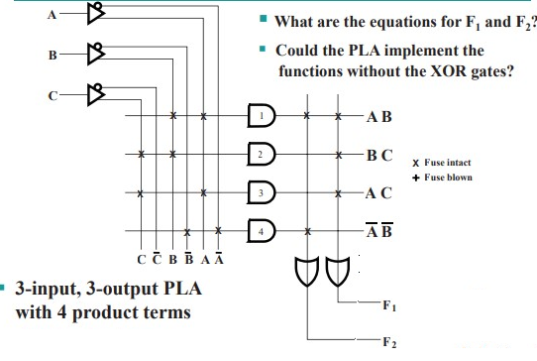
PLA Example

Slide 10
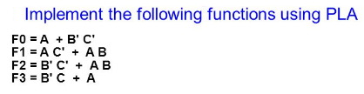

Slide 11
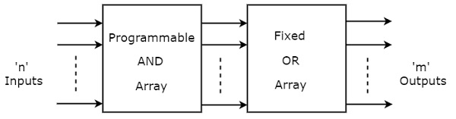
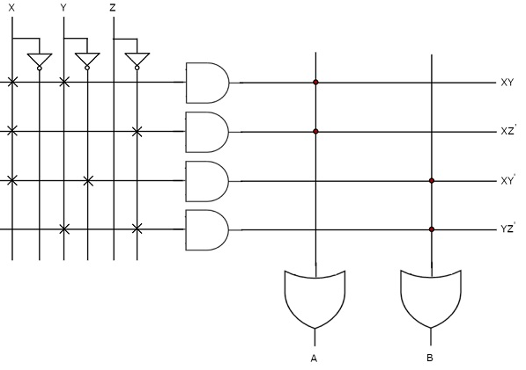
Programming Array Logic
Programmable AND array generates product term
Fixed OR array generates sum
Output of PAL are SOP
The symbol ‘.’ is used for fixed connections
Implement following equation using PAL
A=XY+XZ′
B=XY′+YZ′

Slide 12
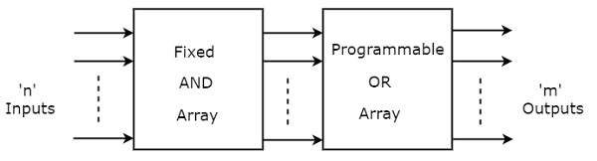
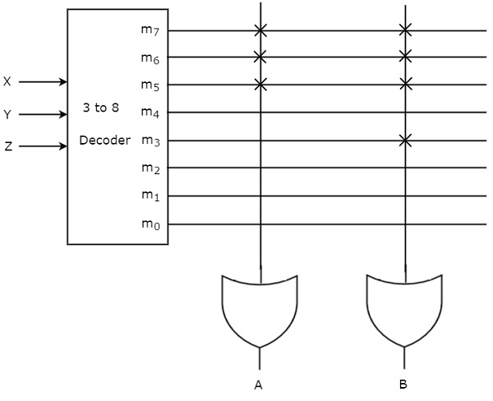
Programmable Read Only Memory PROM
Stores the binary information permanently
User has the flexibility to program the binary information electrically once by using PROM programmer
Fixed AND array (Decoder) & Programmable OR array.
Implement following using PROM
A(X,Y,Z)=∑m(5,6,7)
B(X,Y,Z)=∑m(3,5,6,7)

Slide 13
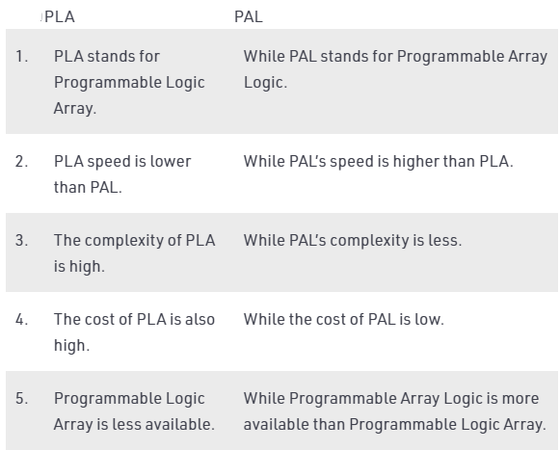

Slide 14
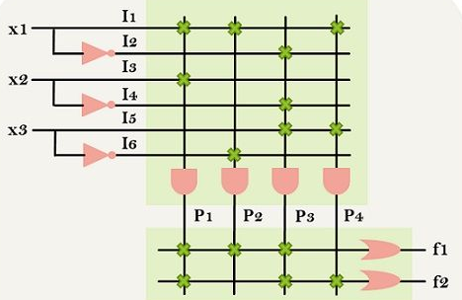
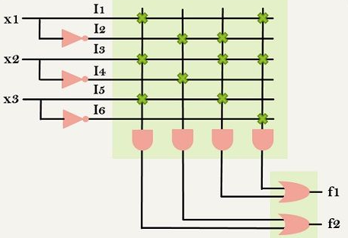
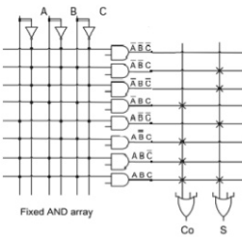
Identify the circuit and find equation
Implement Full subtractor using PLA, PAL and PROM

Slide 15
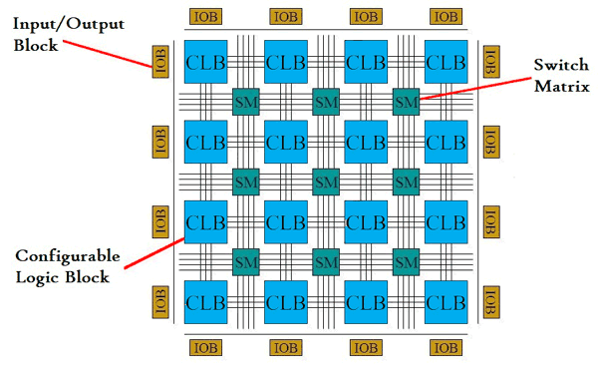
FPGA (Field Programmable Gate Array)
Arrays of logic blocks which are programmable.
It is surrounded by PROGRAMMABLE ROUTING RESOURCES, which allows the user to define the interconnections between the logic blocks.
It has lots of very flexible input and output circuits
Programmable Logic Device can programmed by HDLs
2 major players in the FPGA domain: Xilinx and Altera
Logic blocks implement the logical functions required by the design and consist of various components such as transistor pairs, look-up tables (LUTs), flip flops, and multiplexers.
Programmable interconnection is used for allocating resources among configurable logic blocks (CLBs)
CLB is tied to a switch matrix to access the general routing structure.
I/O blocks (IOBs) are used to interface the CLBs and routing architecture to the external components.

Slide 16
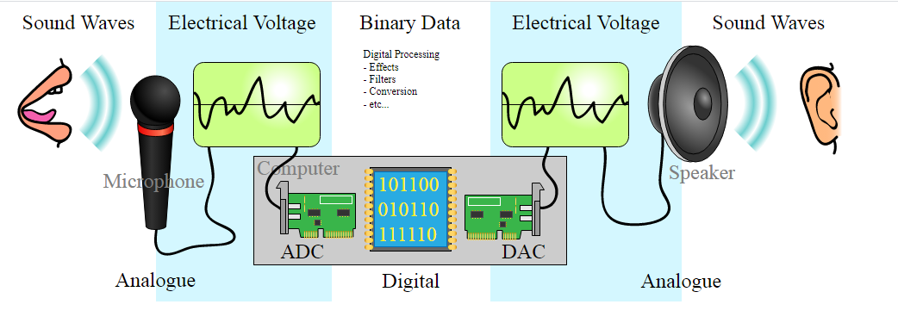
Data Converter
ADC – Analog to Digital Convertor
DAC – Digital to analog Converter

Slide 17
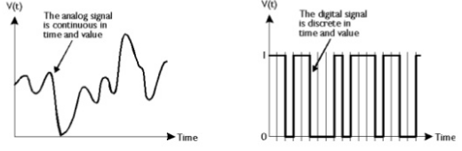
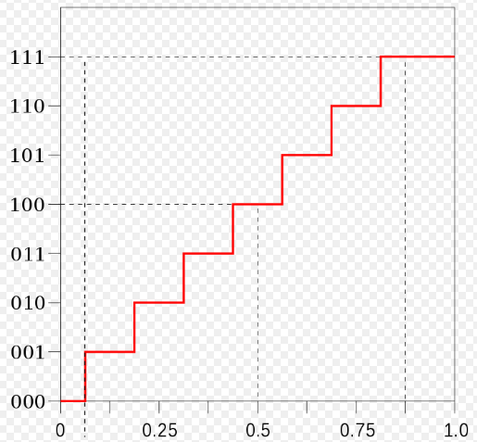

Analog to Digital Converter (ADC)
An electronics circuit converts a continuous analog input signal to discrete digital number (binary)
two discrete states, a logic “1” (HIGH) or a logic “0” (LOW).
conversion involves quantization of the input
Digital Output
Analog Input

Slide 18
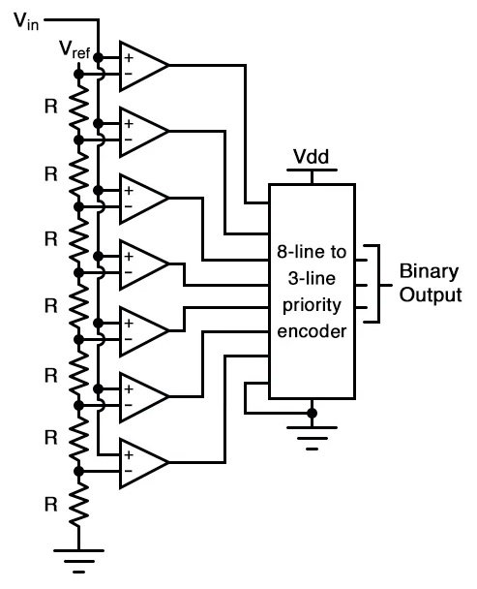
Type of ADC
Flash Type / Comparator Type Parallel ADC
A series of comparators, resistor ladder and a priority encoder
Each comparator compares the input signal to a unique reference voltage.
The comparator outputs inputted of a priority encoder circuit, produces a binary output
Fastest type of ADC
Minimum conversion time
No. of Comparator = 2^n -1
No. of Resistor = 2^n -1
No. of priority encoder =1

Slide 19
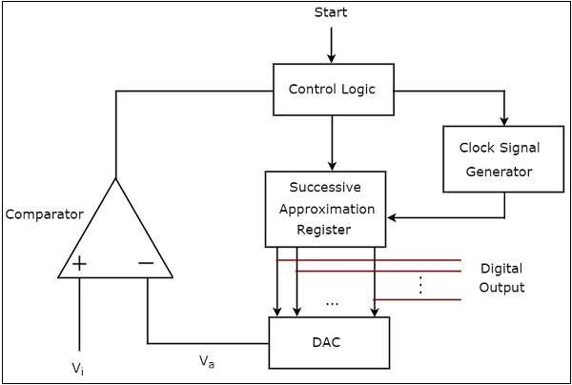
Successive Approximation ADC
Analog input converts into digital output using successive approximation algorithm
Contains Clock signal generator,
Successive Approximation Register (SAR)
DAC
Comparator
Control logic
control logic resets all the bits of SAR
enables the clock signal generator, after start
The binary (digital) data present in SAR will be updated for every clock pulse based on the output of comparator. The output of SAR is applied as an input of DAC.
DAC converts the received digital input, which is the output of SAR, into an analog output.
The comparator compares this analog value Va with the external analog input value Vi
The output of a comparator will be ‘1’ as long as Vi is greater than Va.
Similarly, the output of comparator will be ‘0’, when Vi is less than or equal to Va
The operations mentioned in above steps will be continued until the digital output is a valid one.

Slide 20
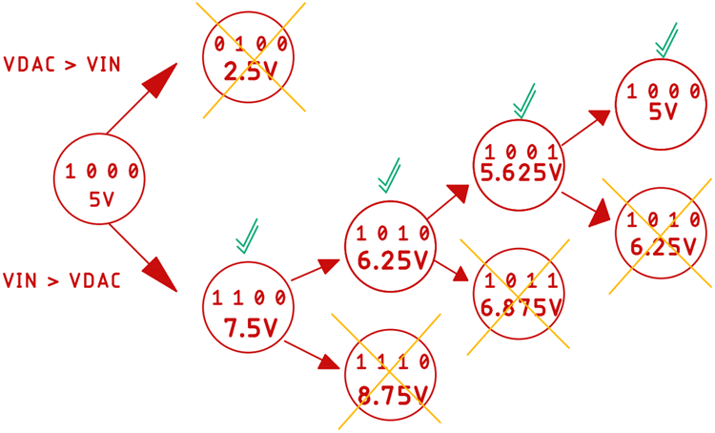
4-bit SAR ADC with input signal is 5.8V and reference is 10V
conversion starts, with sets the most significant bit to 1 and all other bits to zero
DAC will produce a value of 5V
Now this voltage will be compared to the input voltage and based on the comparator output
Vin > Va (DAC output), MSB will stay as it is, and the next bit will be set for a new comparison.
Vin < Va (DAC output), MSB will set to zero, and the next bit will be set to 1 for a new comparison.
Conversion Time:
N bit SAR ADC, take N clock cycles,
conversion time of SAR ADC➔ Tc = N x Tclk

Slide 21
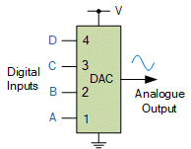
Digital to Analog Converter(DAC)
Accepts n-bit binary input and produces proportional analog signal
Analog output = K × digital input K-propotionality factor
DAC’s convert binary or non-binary numbers into analogue ones with its output voltage (or current) being proportional to the value of its digital input number

Slide 22
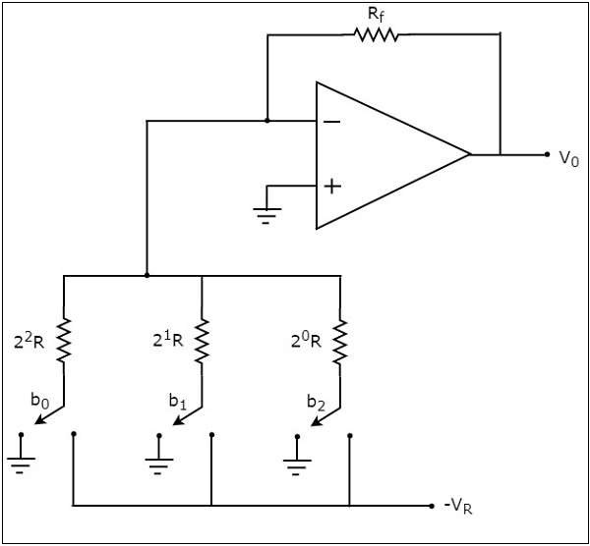
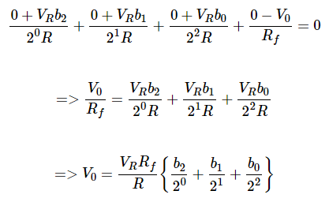
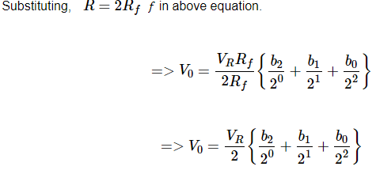
Type of DAC
Binary weighted resistors
Contains OP-AMP, Digital Switch, 2^n resistors
3-bit binary input is b2b1b0 digital switches connected to ground for input bits ‘0’.
connected to the VR for input bits ‘1’
non-inverting input terminal of an op-amp is connected to ground
virtual ground concept, the voltage at the inverting input terminal
of opamp is same as that of the voltage
at its non-inverting input terminal

Slide 23
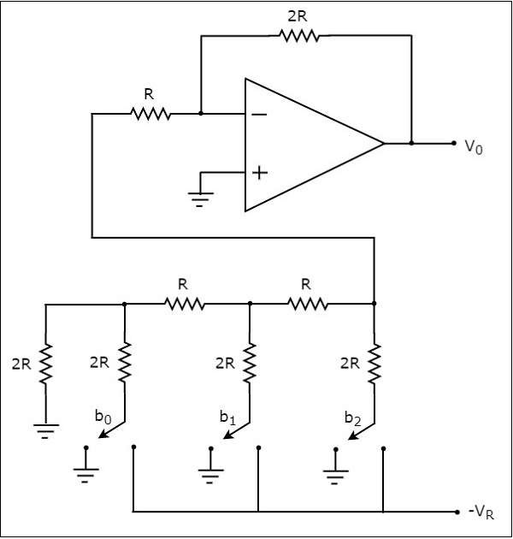

2. R-2R Ladder DAC
Contains R-2R resistor ladder, OP-AMP and digital switch
Only two value of resistor
digital switches connected to ground for input bits ‘0’.
connected to the VR for input bits ‘1’

Slide 24

DAC Specification
1. Resolution- Number of different analog output values can provided by DAC
n-bit DAC Resolution =2^n
Resolution also defined as
Ratio of change in output voltage due to change in 1 LSB at digital input
Full scale voltage of 8-bit DAC is 10.2 V
Resolution = 2^8 = 256
Resolution = 10.2 / (2^8 -1) = 10.2 /255 = 40 mV/LSB
1 LSB change in digital input produces 40 mV analog output
Output voltage of DAC Vo = Resolution * Decimal value of Digital input
VoFS = Full Scale Voltage

Slide 25
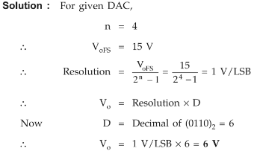
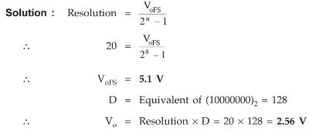
2. Accuracy - Difference between actual output voltage and expected output voltage
Accuracy of DAC 1/2LSB
3. Conversion Time - Time taken for the output to settle within a specified band
settling time ranges from 100 ns to 10 μs
Digital input for a 4-bit DAC is (0110)2
Calculate its final output voltage for full scale output 15V
8-bit DAC have resolution 20 mV/LSB , Find full scale output and
If input in (10000000)2

Slide 26
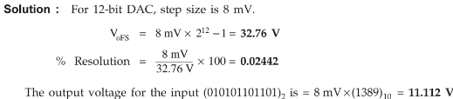
12-bit DAC has a step size 8 mV, determine the full scale voltage and % resolution. Also find the output voltage for the input
(010101101101)2
A 5-bit DAC has a current output. For a digital input of 101000, an output current of 10mA is produced. What will IOUT be for a digital input of 11101?
digital input (10100)2 is equal to decimal 20. Since IOUT = 10 mA for this case, the proportionality factor as 0.5 mA
(11101)2 = (29)10 as follows : IOUT = (0.5mA) × 29 = 14.5 mA

